Slide 1
DATA ANALYTICS ESSENTIALS · REVIEW 2
Weather Data Analysis
System
Daily weather across 10 cities · 2000–2024

Slide 2
1
Approach: from raw data to insights
1
2
3
4
5
Data
Univariate
Groups
Relationships
Time
Load preprocessed daily records
Distributions of temperature, rain, conditions
Compare seasons and cities
Scatter plots and correlations
Yearly trends and monthly seasonality
All charts were built in Python with pandas and matplotlib.

Slide 3
2
Dataset overview
10
24
~91K
8
cities
years (2000–2024)
daily records
core weather variables
Raw variables
Engineered features
Max / min temperature and apparent temperature
Precipitation sum, weather code
Wind speed, gusts and dominant direction
month, year and season
precipitation_log = log(1 + rain)
weather_label (readable weather code)

Slide 4
3
Preprocessing and feature engineering
Date parts
Season label
Month and year extracted from the date to study trends and seasonality.
Each record tagged Winter, Summer, Monsoon or Post-Monsoon.
Log precipitation
Weather label
log(1 + rain) reduces the heavy right skew of daily rainfall.
Numeric weather codes decoded into 10 readable conditions.

Slide 5
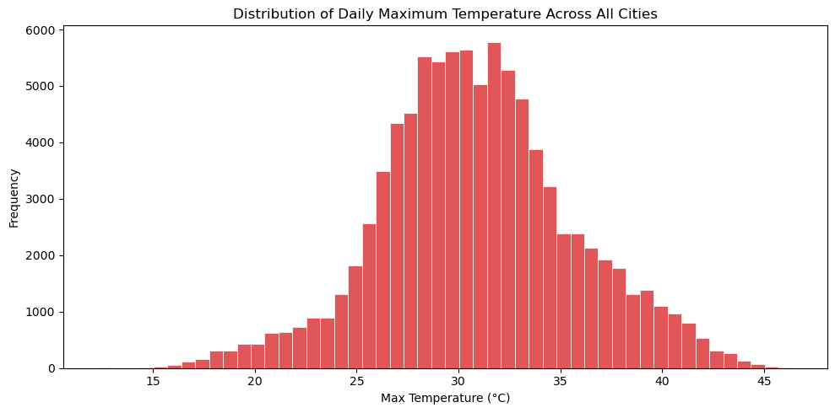
4
Daily maximum temperature
Key insight
Roughly bell-shaped, centered near 30–32°C
Range runs from about 12°C to 46°C across cities
A mild left tail comes from cooler winter days

Slide 6
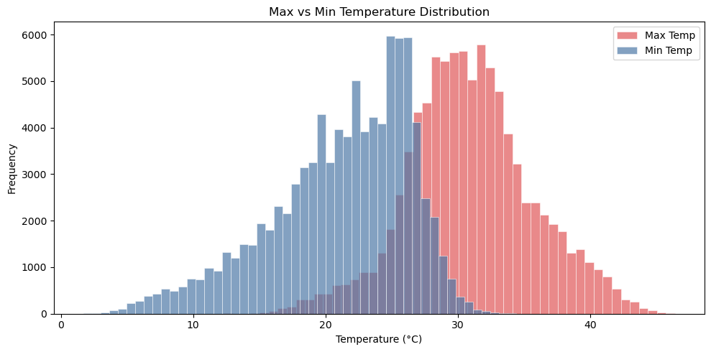
5
Max vs min temperature
Key insight
Max temps cluster around 27–35°C
Min temps peak near 25°C but spread much wider
Distributions overlap in the 25–28°C band

Slide 7
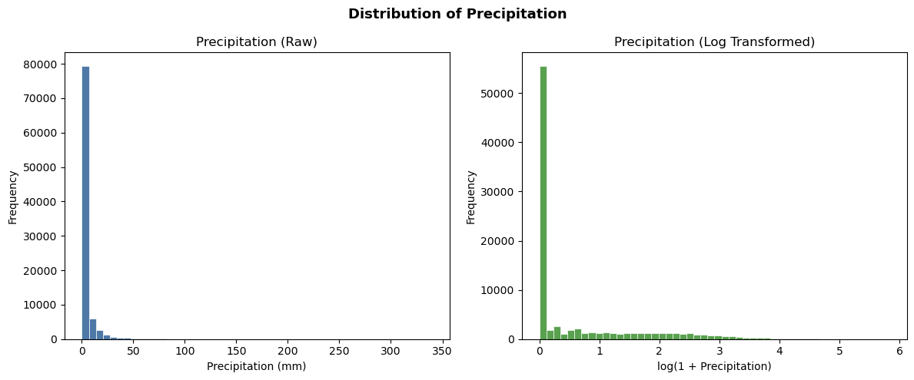
6
Precipitation: raw vs log
Key insight
Most days record zero or near-zero rain
Extreme days reach about 340 mm
log(1 + rain) compresses the long tail for modeling

Slide 8
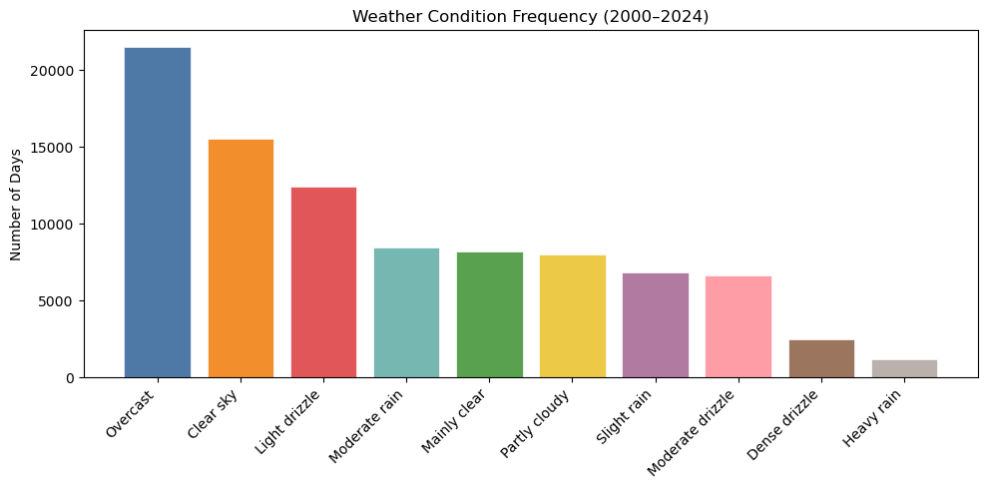
7
Weather condition frequency
Key insight
Overcast is the most common condition (~21K days)
Clear sky (~15K) and light drizzle (~12K) follow
Heavy rain is the rarest, at roughly 1K days

Slide 9
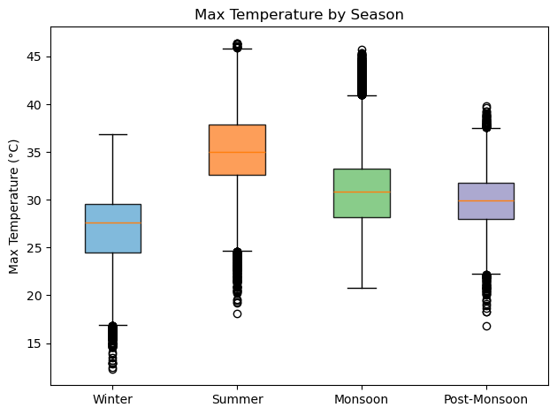
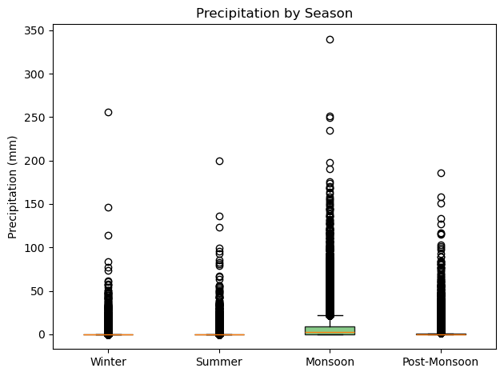
8
Seasonal patterns
Summer is the hottest season (median ≈35°C); the Monsoon brings the highest median rain and the heaviest extremes.

Slide 10
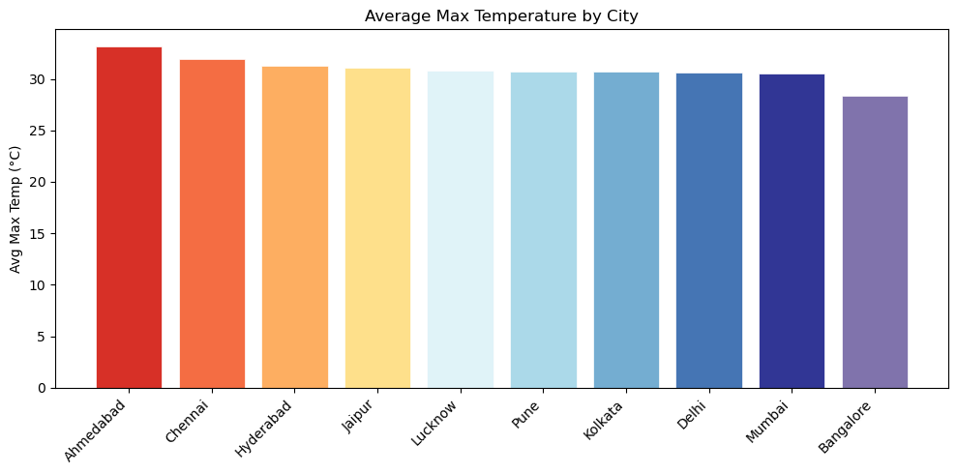
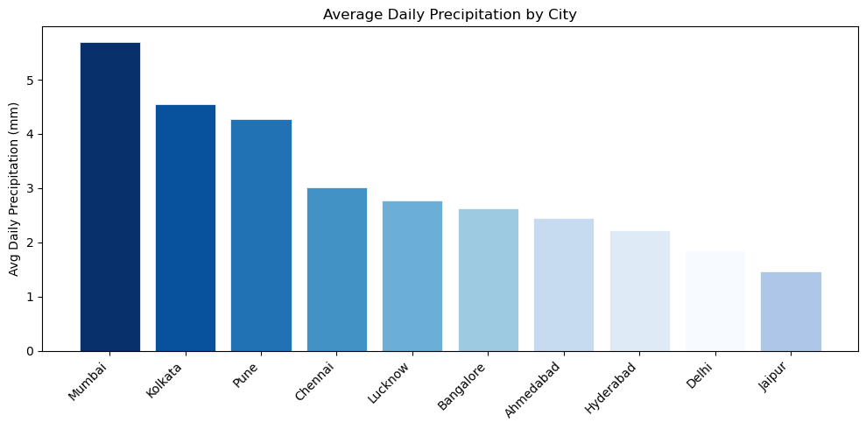
9
City comparison: temperature and rainfall
Hottest city (Ahmedabad, ~33°C) and wettest city (Mumbai, ~5.7 mm/day) differ, so heat alone does not predict rain.

Slide 11
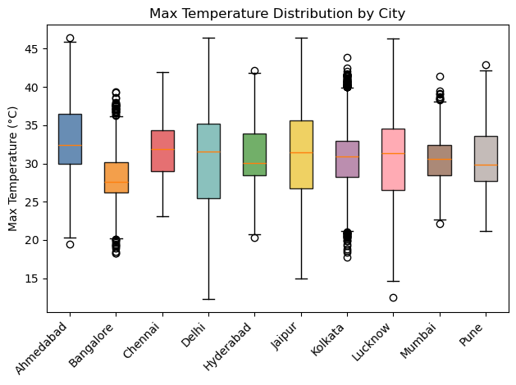
10
Temperature spread by city
Key insight
Delhi, Lucknow and Jaipur swing widest (~12–46°C)
Chennai is steadiest, with a high floor near 23°C
Bangalore is coolest, with a median near 27.5°C

Slide 12
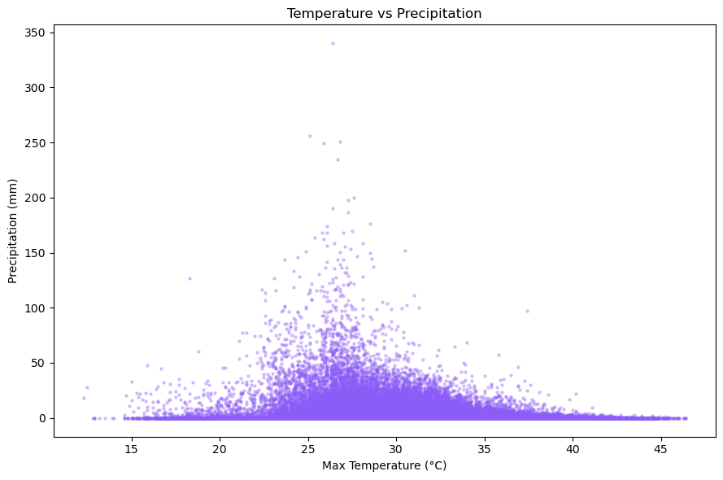
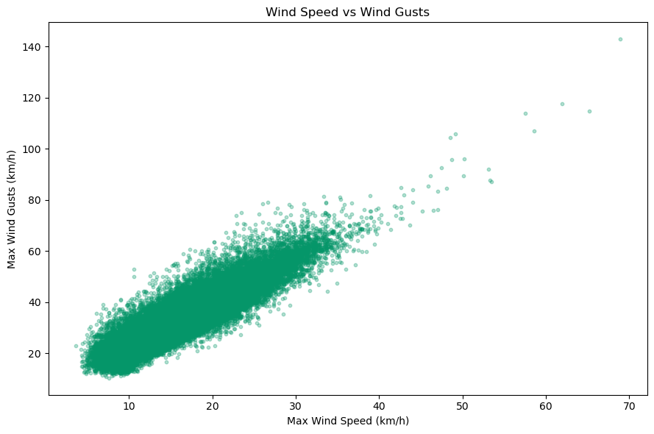
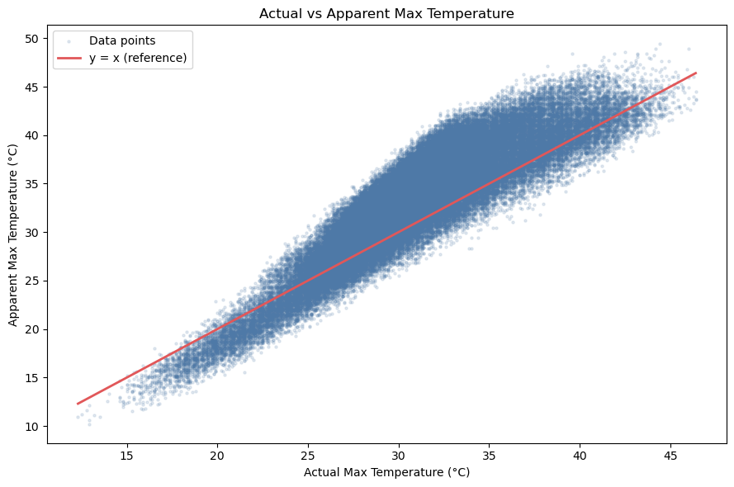
11
Relationships between variables
Rain peaks at 24–32°C and nearly vanishes above ~38°C.
Gusts rise almost linearly with wind speed (r ≈ 0.91).
Apparent temperature is higher than actual in the mid range, lower at extreme heat.

Slide 13
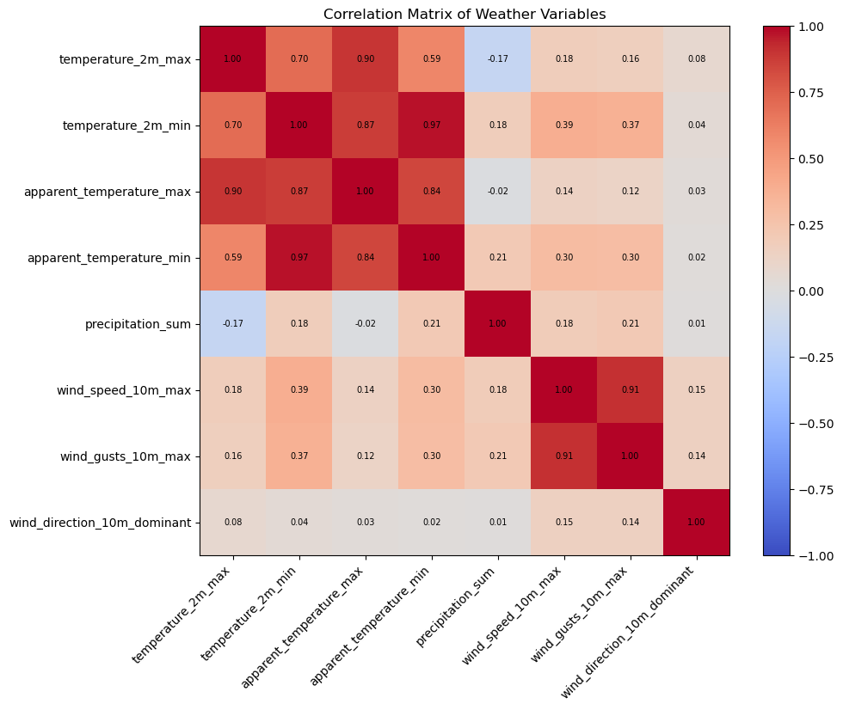
12
Correlation matrix
What stands out
Temperature and apparent temperature: r ≈ 0.90 (max), 0.97 (min)
Wind speed and gusts: r ≈ 0.91
Rain vs max temperature: weak negative (−0.17)
Wind direction is nearly uncorrelated with everything
Redundant pairs are candidates to combine or drop in modeling

Slide 14
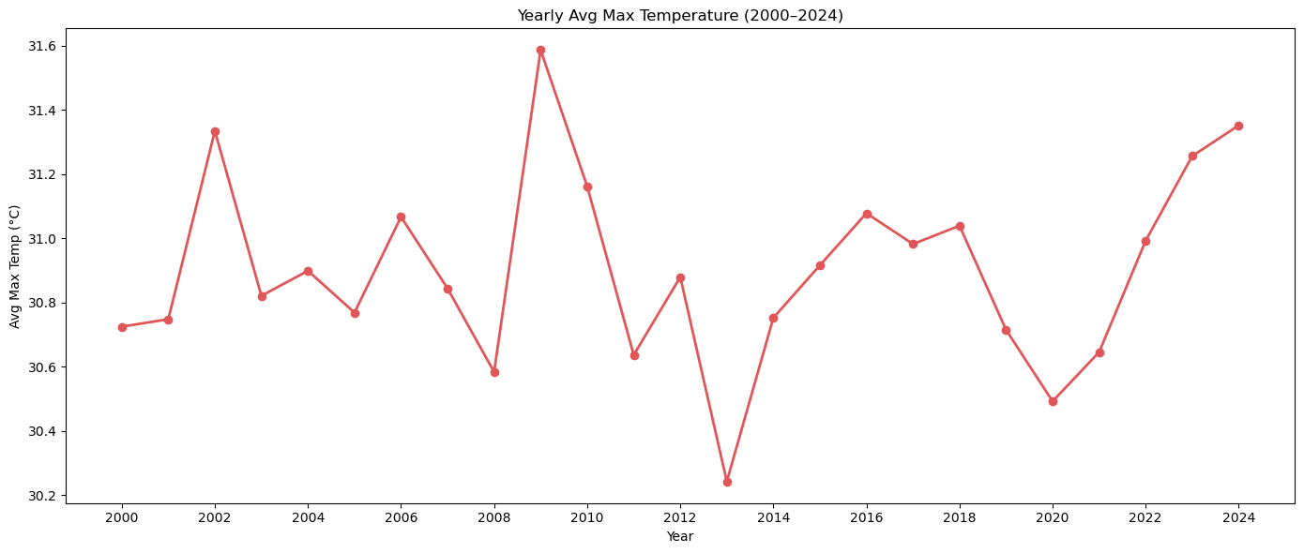
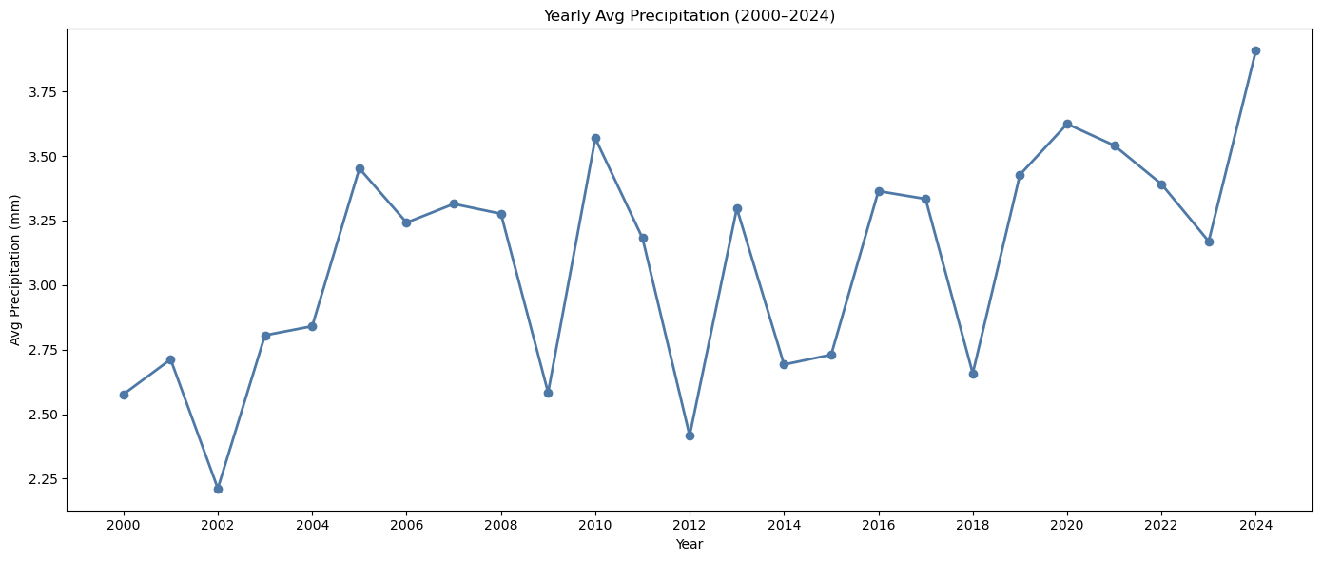
13
Yearly trends, 2000–2024
Average max temperature stays within ~30.2–31.6°C, while average rainfall drifts up from ~2.6 mm to ~3.9 mm; both are noisy year to year.

Slide 15
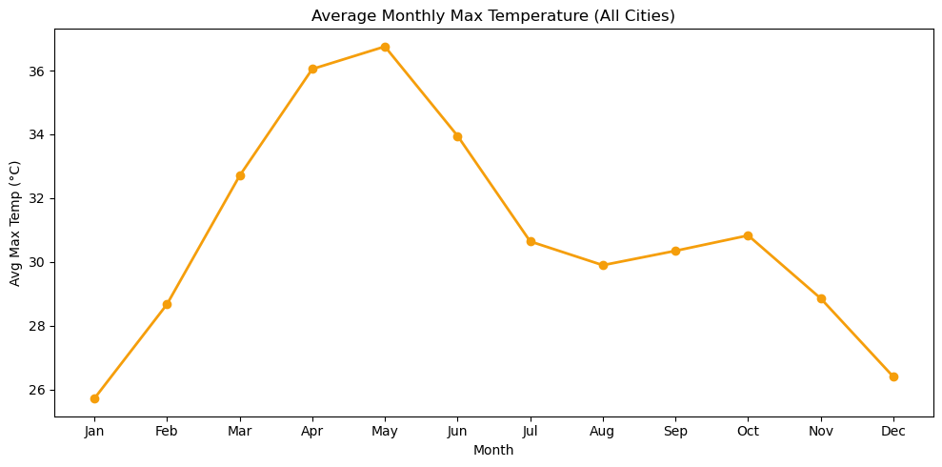
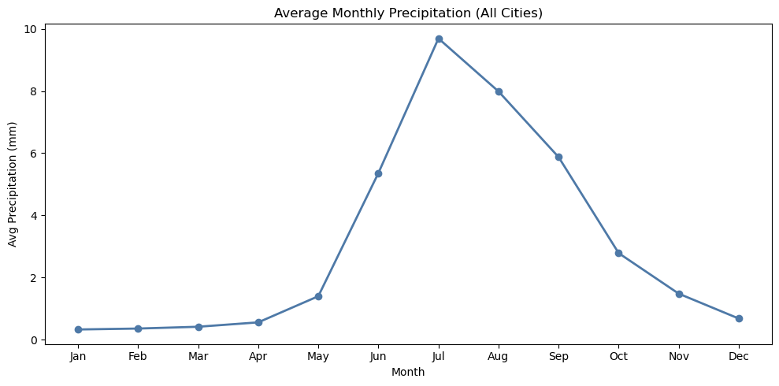
14
Monthly seasonality
Temperature peaks in May (~36.7°C) and rain peaks in July (~9.7 mm); the monthly swing (≈11°C) dwarfs year-to-year change (≈1°C).

Slide 16
15
Key findings
Summer heat
Monsoon rain
Skewed rainfall
Apr–Jun is hottest, peaking in May near 36.7°C.
Jun–Sep delivers most rain, with a July peak.
Most days are dry, so a log transform helps.
City contrast
Redundant features
Weak yearly trend
Ahmedabad is hottest, Mumbai wettest, Bangalore mildest.
Temperature and wind pairs are highly correlated.
Seasonality outweighs year-to-year change.

Slide 17
Conclusion and next steps
What we learned
Next steps
Weather here is driven by strong seasonality
Rainfall is highly skewed and monsoon-dominated
Cities differ clearly in heat, rain and variability
1
Predict daily temperature and rain with ML models
2
Cluster cities by climate profile
3
Decompose and forecast the time series

